Slide 1
Meeting 02/25
Attendants: Ander, David
Ideas for graduation project, and expectations
Background on the DT research

Slide 2
Self Introduction
Embedded Systems program
Relevant courses: System Engineering Design, Real-time systems, Quantitative Evaluation of ES
Software development exp @ ASML, TomTom... and more.
Goal: graduate in late Aug - mid Sep

Slide 3
Motivation
Why Model Based System Engineering (MBSE)?
Reduce maintenance cost in lifecycle
Reduce errors and inconsistency due to iterations
Improve multi-disciplinary collaboration, i.e., engineers from a different job function are able to quickly grasp the high-level overview of the design

Slide 4
Motivation
However, MBSE does not cover well in the followings area:
Numeric computing
Scientific computing,
Visualizations, e.g., 3D physics
Communication systems, e.g., DSP, electromagnetic field
electronic simulation

Slide 5
Related works
Co-simulate or event-based sim MBSE framework (e.g., SysML) with another computational framework (e.g., game engine, MATLAB, etc.)
A layering approach that allows SysML to model the “system decisions”, and the computational framework to model the “calculation decisions”.
Top layer:
SysML
System view
abstraction
Interface
Bottom layer:
Some calculation software
Algorithmic view

Slide 6
Related works
[1] demonstrates co-simulation of SysML and Simulink in the unmanned aerial vehicle (UAV) use case.
[2] demonstrates co-simulation of SysML, Simulink, and Unity in the autonomous driving use case.

Slide 7
Proposed idea
Multimedia network modeling
Raw image frame
Source enc
Channel enc
modulation
Noisy channel
reconstructed image
Source dec
Channel dec
modulation

Slide 8
Proposed idea
SysML to model the building blocks
MATLAB to handle the underlying signal manipulation and probabilistic modeling of the noisy channel
A change of requirements in the system layer (top) will need to translate to the algorithm layer (bottom), while the model-to-model (M2M) or model-to-text (M2T) process should be opaque to the user.

Slide 9
Challenges
In the review of [3], they pointed out the current challenges of co-simulation include:
Parameter transfer
Model transformation
Result feedbacks

Slide 10
Goals
Construct a co-simulation environment to develop a multimedia network model.
Address to known challenges
Investigate additional shortcomings and/or advantages

Slide 11
Meeting 03/08
Attendants: Ander, David, Loek
Discuss research topics

Slide 12
Context
Tao’s [1] 5D model of DT:
Service
VE
PE
data
data
Inter-connections
data

Slide 13
Challenges
Brand et al [2] Identify the following challenges in DT:
Model Consistency:
Maintain dependency relations over the heterogeneous cross-domain models
Need more automations for update & detection of inconsistency
Orchestration:
Dealing with data exchange (for control flow and/or data flow)
➔ handle the interface and encapsulation of models
Validation:
Executions in DT are characterized by time criticality and stochastic nature.
Prone to issues of reachability, deadlocks…etc.
Formal methods like SMT, being used for model checking

Slide 14
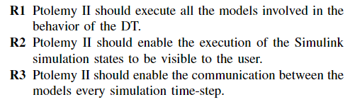
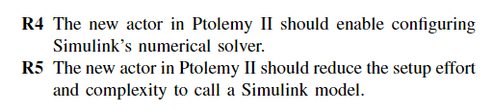
Current Progress
Negrin et al [3] use Ptolemy II to address orchestration
Ptolemy II framework:
A Director implemented under a domain to execute actors’ sequences
Requirements:

Slide 15
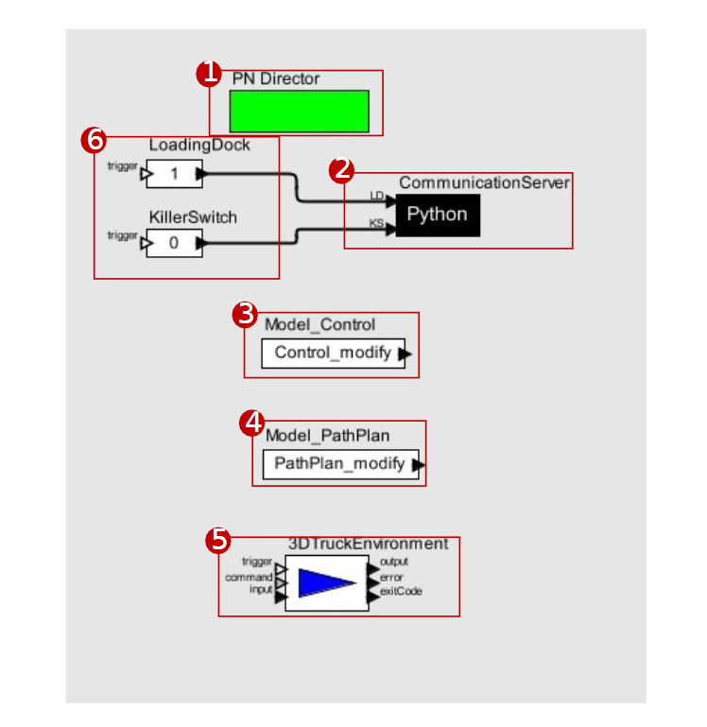
Truck DT use case
Director of process network domain: concurrently execute the models and concurrently exchange data between models
TCP/IP server in Python
PID controller in Simulink
Path selection in Simulink
3D environment model in Unity and MATLAB script
User inputs, LD: destination, KS: start/stop driving

Slide 16
Future works
Implement the data exchange using the Simulink actor’s ports rather than over TCP/IP
Automate the generation of S-functions for Simulink models
Test different communication technologies other than TCP/IP

Slide 17
Meeting 03/23
Attendants: Ander, David, Loek
Overview of DT in biomanufacturing domain

Slide 18
Preparation phase:
Investigate similar services (in DTs) from the (bio-)chemical domain, or relevant other domains.
Investigate and explore technologies for model integration and orchestration, and sensor implementation.
Define KPI’s for the integration and orchestration as a function of the provided service.
Investigate and select platform and MDSE approach for implementing the system (preference is for Ptolemy II).
Decide which DT service and limited set of requirements to (first) implement.

Slide 19
Classification of DT in biomanufacturing
Kritzinger et al [1] classify DTs based on the level of integration:
Digital model
No real-time data exchange, i.e., simulation
Digital shadow
Unidirectional RT data exchange
Digital twin
Bidirectional RT data exchange

Slide 20
Classification of DT in biomanufacturing
Physical plant
Digital shadow
sensors
monitor
Digital model
Model
Digital plant
actuators
control/adjust
Digital twin
Biomanufacturing infrastructures

Slide 21
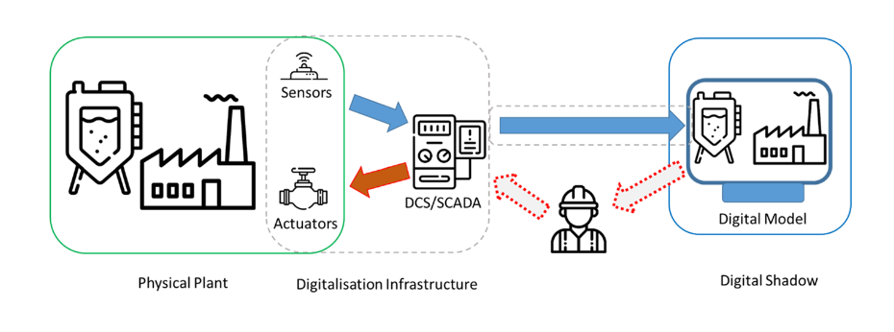
Classification of DT in biomanufacturing
In practice, operator interventions are still often needed in many biomanufacturing scenario. Hence, a more relaxed definition of DT can be used [2][3].
That introduces the requirement of Human Machine Interface (HMI), e.g., GUI.

Slide 22
Technologies of DT in biomanufacturing
Monitoring:
Hardware sensors
Soft sensors
Multivariate data analysis (MVDA) => black box
Artificial neural network (ANN) => black box
mechanistic models => white box
Hybrid => gray box
Model (static or dynamic):
Recursive parameter estimation (RPE)
State estimators, e.g., Kalman filters
Control:
Model predictive control (MPC) [4], e.g., ANN
Self‑optimizing control (SOC), e.g., PID controller

Slide 23
Technologies of DT in biomanufacturing
Communication:
An open platform communications (OPC) infrastructure often contains the following components [12]:
Supervisory control and data acquisition (SCADA) systems and APIs, for monitoring.
Programmable logic controllers (PLC) and APIs for control signal
OPC server for remote access and storage
A chosen file format for data interchange, e.g., XML, JSON
Appropriate protocols to support all of the above respectively, e.g., serial link protocol, TCP/IP…etc.

Slide 24
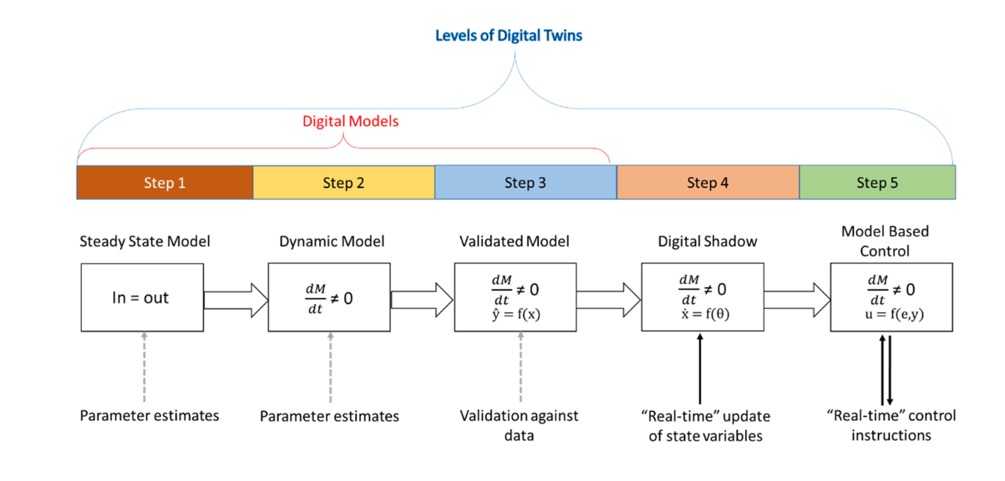
5 Steps toward DT implementation
Udugama et al [2] propose a pathway toward a DT applicable particularly for the (bio)chemical domain.

Slide 25
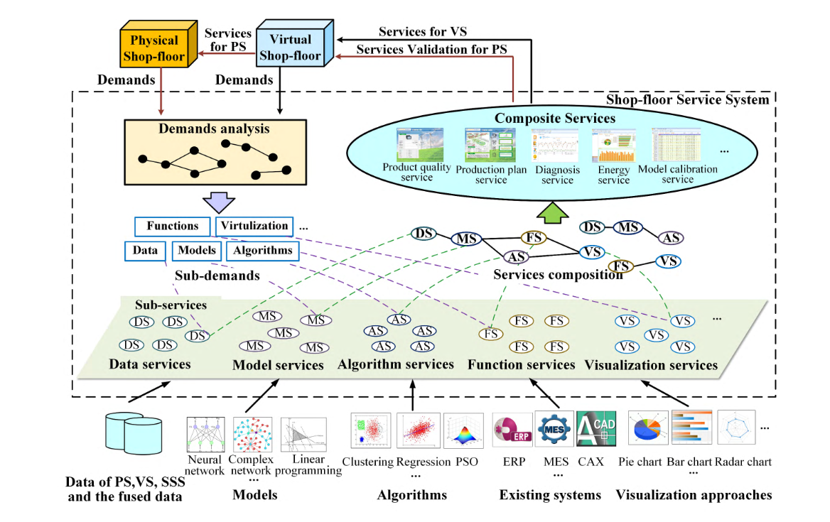
In relation to Tao’s shopfloor paradigm [5]
Step 3-5
Step 1-3
HMI

Slide 26
Related works from (bio)chemical industry
Penicillin production [6], phase 2, step 5
Sample carbon evolution (CER) and the oxygen uptake rate (OUR) into mechanistic model.
Incorporate MPC and PID in MATLAB to adjust the feed rate.
Yeast production [7] , phase 2, step 5
Ion mobility spectrometry (IMS) as monitor
MPC based on reduced metabolic model for dilution rate control
mRNA production [8], phase 2, step 5
Compare the continuously stirred tank reactor (CSTR) approach with the classic batch approach.
The approach is enabled by closed-loop control based on MPC. The accuracy is validated by lab measurements, and the precision is validated by Monte Carlo simulation.
Life cycle [13] : 1) Design, 2) manufacturing, 3) service, 4) retire
Implementation steps: 1) steady state model, 2) dynamic model, 3) validation 4) digital shadow, 5) DT

Slide 27
Related works from (bio)chemical industry
Enzyme production [9], phase 2, step 5
A supervisory layer (mechanistic model) and a regulatory layer (PID), both implemented in MATLAB, and connected to a OPC server.
Ethanol fermentation [10], phase 2, step 5
Inferential measurements from ATR-MIR spectrophotometer
Python to perform partial least square (PLS) regressions, then prediction
LabView to send the control signals
Spent sulfite liquor (SSL) bioprocessing [11], phase 2, step 5
CSTR method with adaptive control implemented in MATLAB
Life cycle [13]: 1) Design, 2) manufacturing, 3) service, 4) retire
Implementation steps: 1) steady state model, 2) dynamic model, 3) validation 4) digital shadow, 5) DT

Slide 28
Meeting 03/30
Attendants: Ander, David, Loek
Discussion on the requirements of orchestration and integration

Slide 29
Agenda
Definitions of orchestration and integration
Technologies for orchestration
Ptolemy II
SysML
DT as SOA
Desirable qualities for orchestration
Technologies for integration
CAPE-OPEN
FMI
Desirable qualities for integration

Slide 30
Definitions
Orchestration
Deciding the control & dataflow properties between models
Integration
Encapsulate individual model
Construct an interface for data exchange
Model A
Model A
1
Model B
2
Model C
4
order
information
interface
time
3
encapsulation
Model B

Slide 31
Orchestration: Ptolemy II [1]
Coordinate actors of various models of computation (MoC) while maintaining strong semantic of each individual model
MoC examples:
Process network (PN), synchronous data flow (SDF):
Scheduling for concurrent distributed processes
Determinacy: unique solution of balance equation
Implicit assumptions: time-invariant, data independence
Finite state machine (FSM)
Capture control-dominated behaviors [2]
Discrete event (DE)
Suited for modelling the behaviours of complex systems over time [1], e.g., queueing systems
Continuous time
Modeling ODE

Slide 32
Orchestration: SysML [3]
Dialect of UML intended for MBSE
Rich static and dynamic behavioural information
Static diagram examples:
Block Definition Diagram (Black Box)
Internal block diagram (White box)
Requirement diagram (Declarative)
Behavioural diagram examples:
Activity diagram
Sequence diagram
State Machine diagram

Slide 33
DT as service-orientated architecture (SOA)
Regard models in DT as independent cloud-native microservices [4].
Deploy DT as containers and orchestrate them with application such as Kubernetes.
Fast deployment, and auto monitoring/scaling/load balancing. Suitable for continuous integration (CI) [5].
Still have to handle data integration somehow.

Slide 34
Desirable qualities for orchestration
Control workflow [1][6]
Support priority scheduling, atomicity, and concurrency
Maintain an event queue in deterministic fashion
Ontology checking [1]
Check consistency of unit, constant, semantics, etc.
Managing mixed fidelity [1][2]
Time synchronization
Continuous-discrete dynamic conversion
Signaling between time & untimed models

Slide 35
Integration: CAPE-OPEN [8]
Component-based approach to process simulation, especially for the chemical manufacturing domain.
Process Modelling Components (PMC), examples:
Thermodynamic and Physical Properties component
Numerical Solvers
Sequential Modular Specific Tools component
Process Modelling Environments (PME): flowsheet that utilize services from PMCs

Slide 36
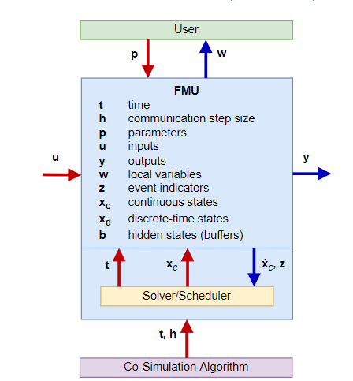
Integration: FMI [10][11]
Master-slave interface consists of functional mockup units (FMU).
API: init, dostep, get, set
FMU is the encapsulation of model in XML format, which contains model variables, timestep information, etc.

Slide 37
Desirable qualities for integration
Configurability
Adjustable initialization and ordering of the subsystems [12]
Support multirate modelling with dynamic time management [10][13]
Automation
Automatic code generation for export [12][14][15]
Data exchange
Able to transfer structural data [13]
Consistency of variables mapping [14]
Plug & play
Easily moving models from one computational node to other
=> support template and instantiation [13]

Slide 38
Meeting 04/06
Attendants: Ander, David

Slide 39
Agenda
Definitions of orchestration and integration
Requirements and corresponding implications w.r.t O&I
Production prediction
Production control
What-if scenarios
Predictive maintenance

Slide 40
Definitions of O&I
Orchestration
Dictates models’ sequence of executions and arranges event queue for the event instances that are triggered by respective model.
Integration
Encapsulates the necessary attributes and properties of a model, followed by transmitting the marshalled data to other models at a given communication time.

Slide 41
O&I characteristics
Orchestration (O)
Control workflow and execution sequence
Ontology checking
Managing mixed fidelity
Integration (I)
Configurability of parameters and time advancement
Automated code/data generation
Data exchange consistency
Plug & play (minimum manual setup)

Slide 42
S1 Production prediction
Goal: predict the end-product and whether its quantity and quality will meet the demand, based on the given materials and resources.
Distinctive requirements:
Model state variables shall be validated with RT empirical data [1].
O2, O3, I3
The operator shall be able to configure the initial model parameter based on the given materials and resources.
I1
The model parameters shall be automatically updated based on the latest RT data [2].
O1, I2, I3

Slide 43
S2 Production control
Goal: organize the production schedules and regulate the process such that the utilization of resources is optimized
Distinctive requirements [3]:
The model optimization may be triggered on the detected disturbance, time, or plantwide performance.
O1, O2, O3
The controller calibration may be triggered on time, or state variables deviation.
O1, O2, O3, I2

Slide 44
S3 What-if scenarios
Goal: create hypothetical situation and predict its effect on the production, in order to generate various iterations of the production schedule.
Distinctive requirements:
The scenario-dependent data shall be stored and handled separately from the master data [4].
I4
The scenario can be readily reset, applied, and removed without affecting the master schedule.
O1, I1, I2, I4
The iterations of scenario may be managed under version control.
I2

Slide 45
S4 Predictive maintenance
Goal: using data stream from the plant and physical-based modelling to generate a prognosis of the remaining lifetime of plant components.
Distinctive requirements:
Dynamic data acquisition shall be integrated autonomously to update the static attributes in the predictive model [5].
O1, O2, O3, I2, I3
Both real-life measurements and simulated results shall be used in the retrofitting of the predictive model [6].
O1, O2, I1, I2

Slide 46
Meeting 04/13
Attendants: Ander, David, Loek
The services and their KPIs (cont’)

Slide 47
Agenda
S1 Production prediction:
[New] Utilizing historical data
S2 Production control
[New] Operation point searching
S3 What-if scenarios
[KPI] Scalability, accessibility
S4 Predictive maintenance
[New] Data preprocessing

Slide 48
O&I characteristics
Orchestration (O)
Control workflow and execution sequence
Ontology checking
Managing mixed fidelity/granularity
Integration (I)
Configurability of parameters and time advancement
Automated code/data generation
Data exchange consistency
Plug & play modularity

Slide 49
S1 Production prediction
Goal: predict the end-product and whether its quantity and quality will meet the demand, based on the given materials and resources.
# | Requirements | O & I
1 | The model state variables shall be validated with RT empirical data [1]. | O2, O3, I3
2 | The operator shall be able to configure the initial model parameter based on the given materials and resources. | I1
3 | The model parameters shall be automatically updated based on the latest RT data [2]. | O1, I2, I3
4 | The model may be interrogated for its past instances in order to optimize its present parameters [3]. | O1, I1, I4

Slide 50
S1 KPIs
# | Indicator | Description | Relevance
1 | Rate of convergence | How fast the error of prediction against real-world data reaches an accepted lower threshold | R1, R4
2 | Latency | How far is the model time behind real-world time | R3
3 | Data availability | What is the amount historical data that are useful in performing prediction | R4
4 | Reconfigurability | How many parameters need to be set at startup time, and How many can be adjusted during runtime | R2

Slide 51
S2 Production control
Goal: organize the production schedules and regulate the process such that the utilization of resources is optimized
# | Requirements | O & I
1 | The model optimization may be triggered on the detected disturbance, time, or plantwide performance [4]. | O1, O2, O3
2 | The controller calibration may be triggered on time, or state variables deviation [4]. | O1, O2, O3, I2
3 | The model shall ensure that the calibrations comply with the controllers ‘ desired operating range | O1, O2, I1

Slide 52
S2 KPIs
# | Indicator | Description | Relevance
1 | Stableness of transitory behaviors | How long is the overshoots or undershoots period occurring before steady state | R3
2 | System timeliness | What is the response time of triggering | R1, R2

Slide 53
S3 What-if scenarios
Goal: synthesize hypothetical situations and predict the effect on the production, in order to generate various iterations of the production schedule.
# | Requirements | O & I
1 | The scenario-dependent data shall be stored and handled separately from the master data [5]. | I4
2 | The scenarios shall be readily applied, reset, and removed without affecting the master schedule. | O1, I1, I2, I4
3 | The iterations of scenario may be managed under version control. | I2

Slide 54
S3 KPIs
# | Indicator | Description | Relevance
1 | Scalability | To what extent are the additional space and time bounded | R1, R2, R3
2 | Accessibility [6] | Are the model instances of the scenarios easily accessible to the operator | R1, R3
3 | Modularity | Is changeover of the setup for each scenario easily adaptable | R2

Slide 55
S4 Predictive maintenance
Goal: using data stream from the plant and physical-based modelling to generate a prognosis of the remaining lifetime of plant components.
# | Requirements | O & I
1 | Dynamic data acquisition shall used to update the static attributes in the predictive model [7]. | O1, O2, O3, I2, I3
2 | Both RT measurements and simulated results shall be used in the retrofitting of the predictive model [8]. | O1, O2, I1, I2
3 | Data ownership shall have high degree of flexibility and be transferable within the DT in order to perform efficient data prepossessing [9][10]. | O3, I2, I3

Slide 56
S4 KPIs
# | Indicator | Description | Relevance
1 | Accuracy | What is the error of the predictive model against real-world measurement [9] | R1, R2
2 | Impact of missing data | How missing data may affect the overall performance of predictive model | R1, R2
3 | Data quality | How much volume, variety, and veracity of the data is lost as the result of transferring and fusion | R3

Slide 57
Meeting 04/20
Attendants: Ander, David, Loek
Discuss the choice of development environment

Slide 58
Selection criteria
The development environment should support:
Meeting the proposed requirements for the services
Able to make measurements of the KPIs

Slide 59
Potential candidates
Ptolemy II (with possibly extra adaptations)
Build a new platform from software stack, presumably following service-oriented architecture (SOA) design pattern.
Some example frameworks:
TwinOps [1]
M2M network [2]

Slide 60
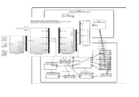
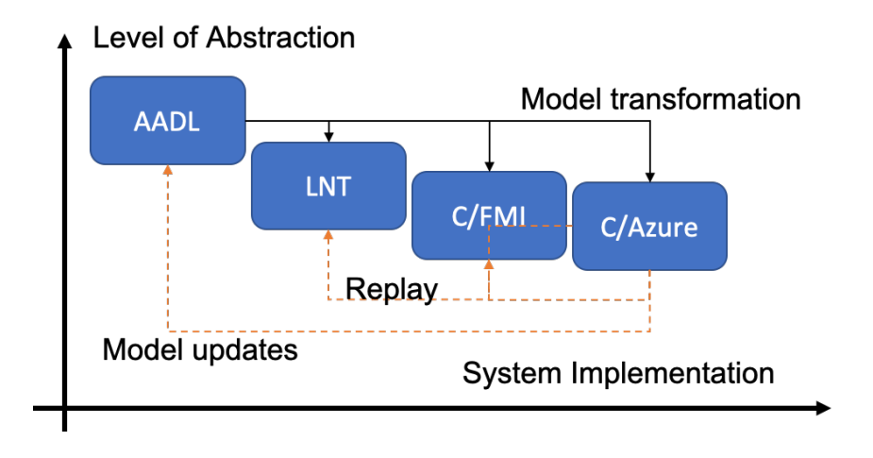
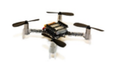
TwinOps
Dev (generate models and codes) and Ops (collects data and confront data consistency)

Slide 61
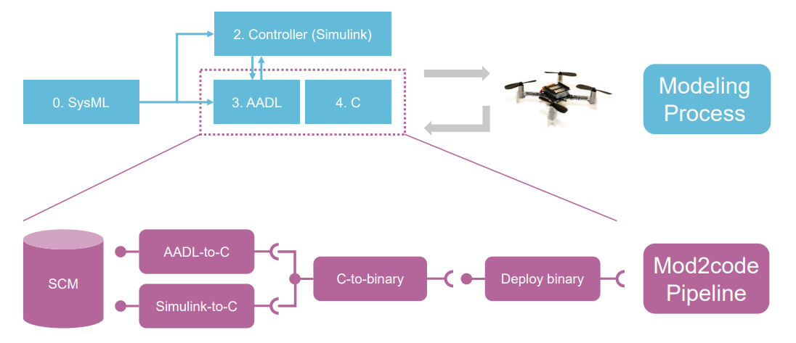
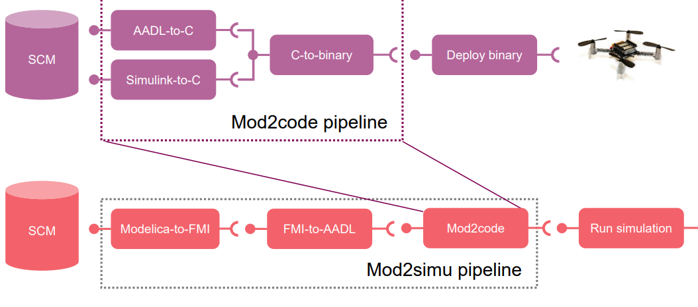
TwinOps
Code generation pipeline

Slide 62
TwinOps
TwinOps benefits:
Bridging the Dev and Ops
⇒S1R4, S2R1R2R3, S4R1R3
Multiple targets code generation
⇒S1R2, S3R1R
Reproducible and traceable runtime activities by containerization toolchain
⇒S4R2, S3R3

Slide 63
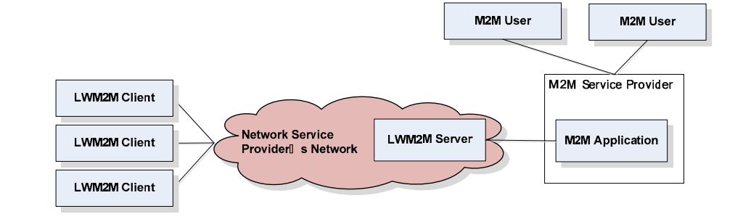
M2M network
Deployment architecture

Slide 64
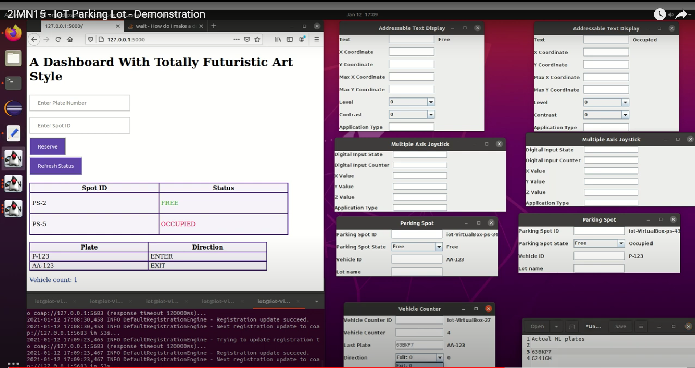
M2M network

Slide 65
M2M network
M2M network benefits from mature protocols for:
bootstrapping and registration
⇒ S1R2R4, S3R3
data config/setting/updating
⇒ S1R1R3, S2R1R2R3, S4R1
object-oriented management
⇒ S2R1R2, S4R3

Slide 66
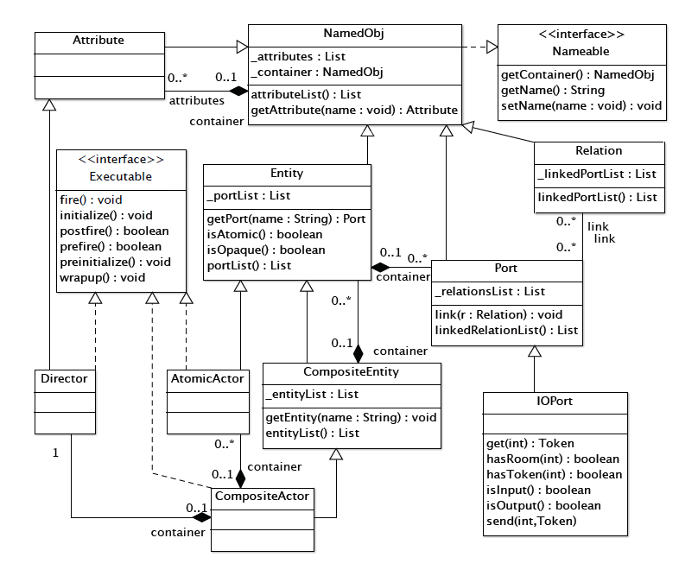
Ptolemy II meta model

Slide 67
Meeting 04/28
Attendants: Ander, David, Loek
Examine the frameworks’ capabilities to support the case study

Slide 68
Agenda
Discuss the deficiencies (and the possible remedies) of the considered frameworks w.r.t supporting the case study
Sensors and actuator connectivity

Slide 69
The “Frameworks”
The frameworks are at different levels of abstraction
SOA:
a design pattern
TwinOps:
a methodology
Ptolemy II:
a software package
Open Self-contained

Slide 70
Deficiency 1
To capture the high-level relationship of the DT entities, and to check its soundness.
Related I&O: workflow consistency, ontology checking
Ptolemy II: somewhat self-explanatory graphical modelling environment
TwinOps: describes the usage of SysML and refined by AADL
SOA: not specified
Solution: use MBSE instruments such as SysML, UML to support preliminary analysis

Slide 71
Deficiency 2
Schedulablility analysis and implementing schedules
Related I&O: execution sequence
Ptolemy II: built-in MoCs and receiver queues (FIFO, LIFO, etc).
TwinOps: AADL as master algorithm for the FMUs.
SOA: some protocols have specified (layered-)control scheme and the option to place objects in logical group
Solution: (Additional) sequence diagram to formalize the control and data flow

Slide 72
Deficiency 3
Adopt a data communication pattern which specify buffers, ports, etc.
Related I&O: data/parameters exchange, code generation
Ptolemy II: transform the models to “actors” and use the environment’s internal “relations” and “ports”.
TwinOps: Connection schemes defined in AADL, then being generated binaries (containerized) to specific target
SOA: common IoT strategies such as client/server, pub/sub, etc
Solution: utilize mature protocols and cloud technologies for automation

Slide 73
Deficiency 4
Configuration and artifacts management, such as logging, reporting
Related I&O: configurability, use of historical data
Ptolemy II: not specified
TwinOps: describes the usage Azure IoT platform
SOA: commonly relies on database system and/or cloud servers
Solution: build an offline or cloud DB with emphasis on automation and version control

Slide 74
Sensors and actuators
 | ITC-308-WIFI Temperature Controller | Sonoff SNZB-02 Temperature and Humidity Sensor | Tilt Wireless Hydrometer | PLAATO Airlock | Woox R5024 Smart Plug (pump)
Data | Temperature, Control signal | Temperature, Humidity | Gravity, Temperature | Variety (bubble, abv, gravity …etc.) | Switch signal
Direction | Bidirectional | Monitor | Monitor | Monitor | Control
Connectivity | IFTTT | Zigbee2MQTT bridge | Google sheet API, Raspberry Pi | Official REST API | IFTTT

Slide 75
Connections architecture (TBD)
Woox R5024
Smart Plug (pump)
ITC-308-WIFI
Temperature Controller
Tilt
Wireless Hydrometer
IFTTT
HTTP
PLAATO
Airlock
REST
DT
REST
Google API
MQTT
ZigbeeMQTT
Sonoff SNZB-02
Temperature and Humidity Sensor

Slide 76
Meeting 05/12
Attendants: Ander, David, Loek
Discuss implementation plan

Slide 77
Agenda
Blueprint
Service implementation order

Slide 78

5D architecture
blue: VE
orange: Service
green: PE
cylinder: Data
dash arrow: abstraction
solid arrow: communication
LwM2M
Ptolemy II
TwinOps
Model1
Model2
FMU1
FMU2
Co-simulation planning
LwM2M
Client
LwM2M
Client
CI/CD pipeline
(validation)
LwM2M
Server
(rule engine)
Ptolemy II
(Actor-Director)
Source management
database
feedback
Code generation
Container
LwM2M
Client
Targets
deploy

Slide 79
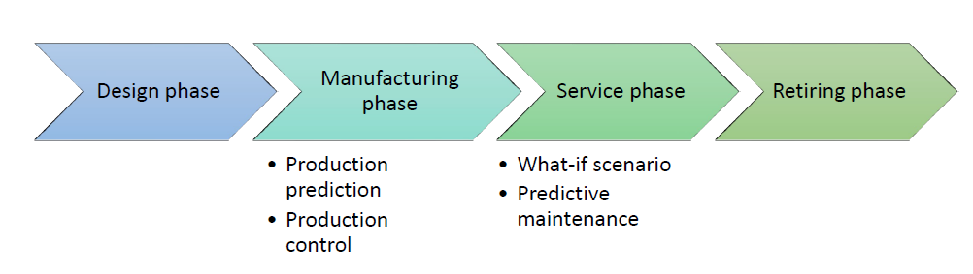
Priority
1. Production Prediction
Concerns with modifiability (I), historical instances (I&O)
Less time critical
2. Production control
Concerns with optimization from dynamic data retrofitting (I&O)
Calibration and micromanagement challenges ☹
3. What-if scenarios
A natural progression from S1
Concerns with modularity (I)
4. Predictive maintenance
Concerns with optimization from dynamic data retrofitting (I&O)
Computational models coupling challenges., e.g., simulation vs predictive ☹

Slide 80
Meeting 05/30
Attendants: Ander, Loek
Update on implementation progress

Slide 81
Agenda
Update on implementation progress
TwinOps: basic workflow successfully built
LwM2M: some adjustments proposed

Slide 82

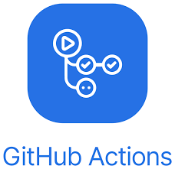

TwinOps
blue: VE
orange: Service
green: PE
cylinder: Data
dash arrow: abstraction
solid arrow: communication
LwM2M
Ptolemy II
TwinOps
Model1
Model2
FMU1
FMU2
Co-simulation planning
CI/CD pipeline
(validation)
Source management
feedback
Code generation
Container
Targets
deploy
82

Slide 83
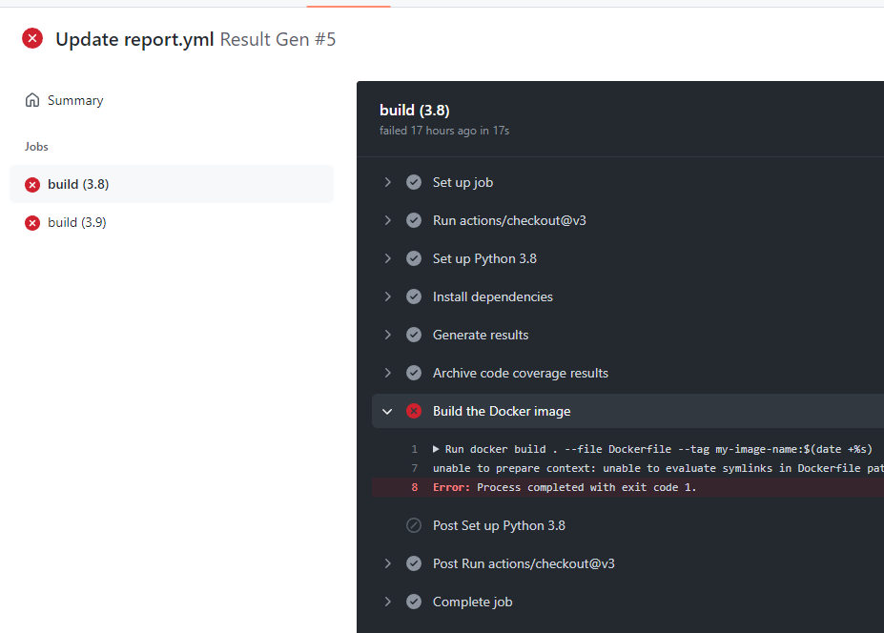
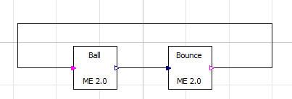
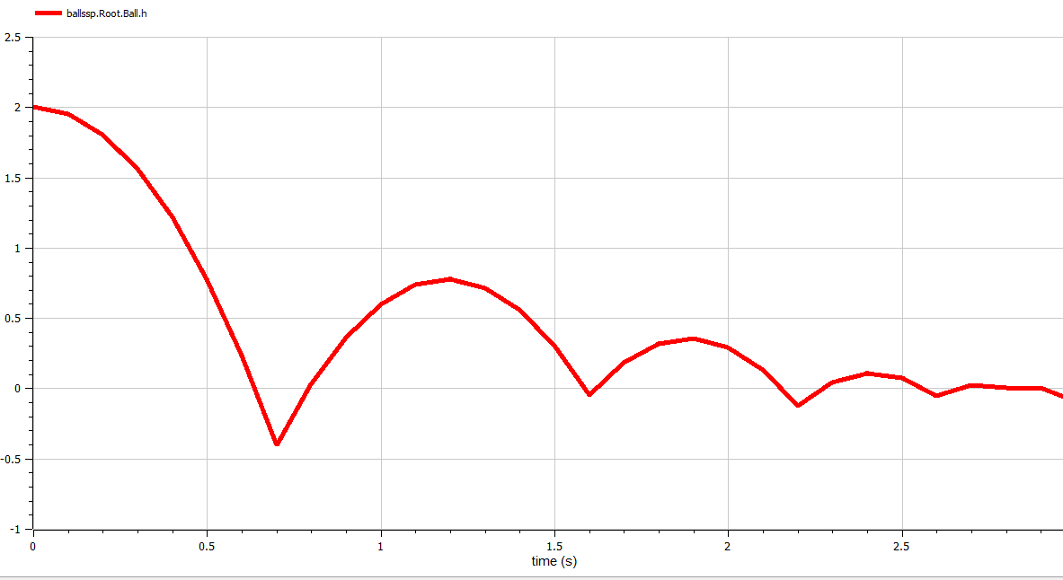
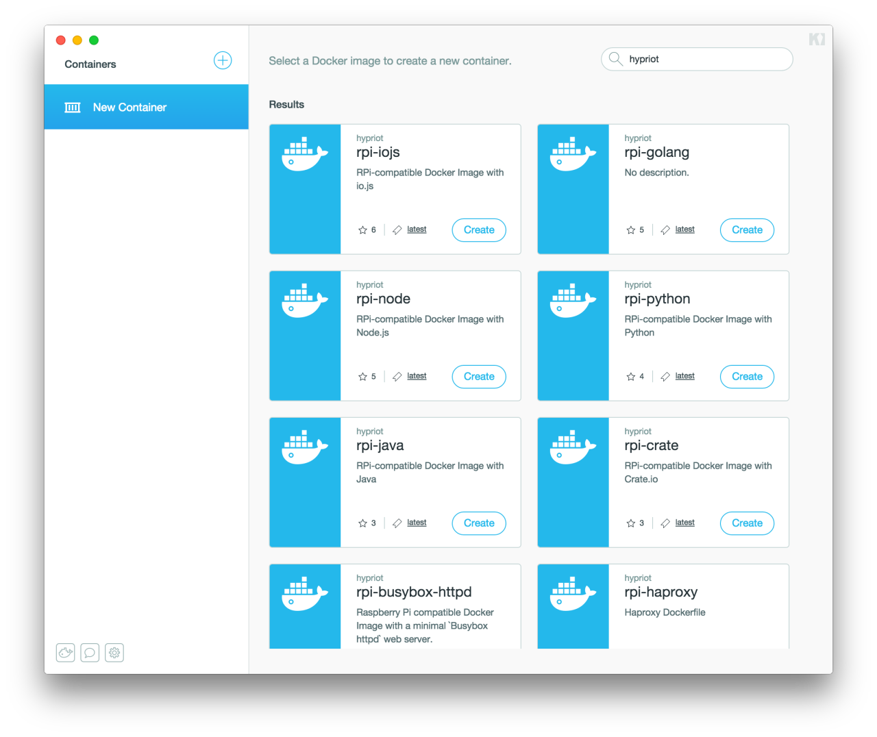
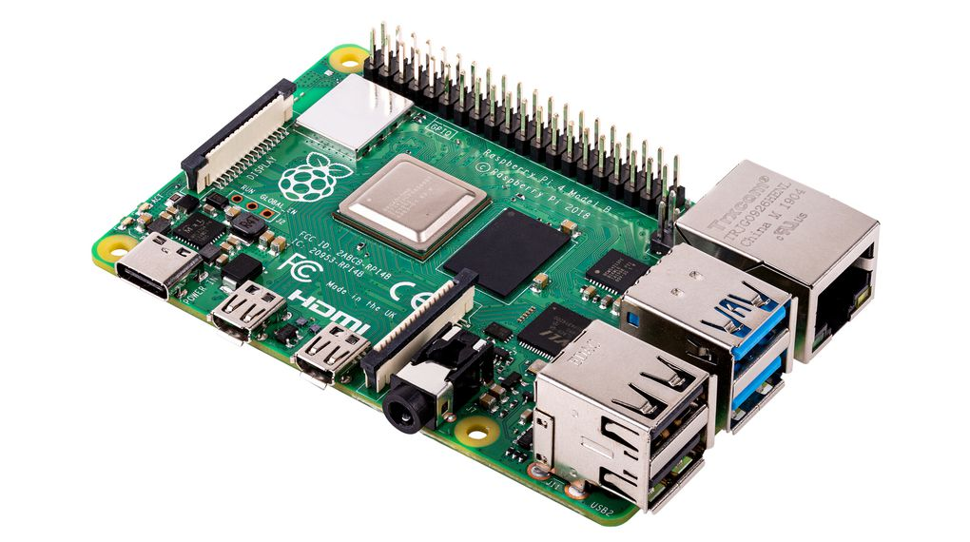
TwinOps – Bouncing ball example

Slide 84
LwM2M
Issues:
Most libraries are designed for POSIX (reasonable for IoT devices), yet many models are built on Windows
→ porting efforts
LwM2M objects are best developed with contexts during prototype stage. Late-transformations (model to clients) introduce many additional works.
Solution:
Relax the scope of LwM2M to more opened M2M design.
→ more flexible toolchains and choices

Slide 85
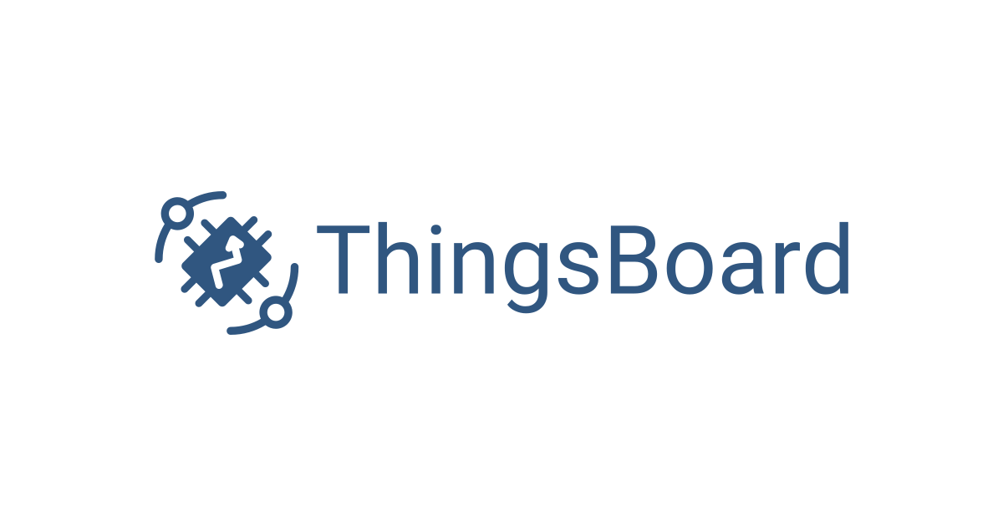

LwM2M M2M
blue: VE
orange: Service
green: PE
cylinder: Data
dash arrow: abstraction
solid arrow: communication
M2M
Ptolemy II
TwinOps
Model1
Model2
M2M
Client
M2M
Client
Server
(rule engine)
database
M2M
Client
Targets
85

Slide 86
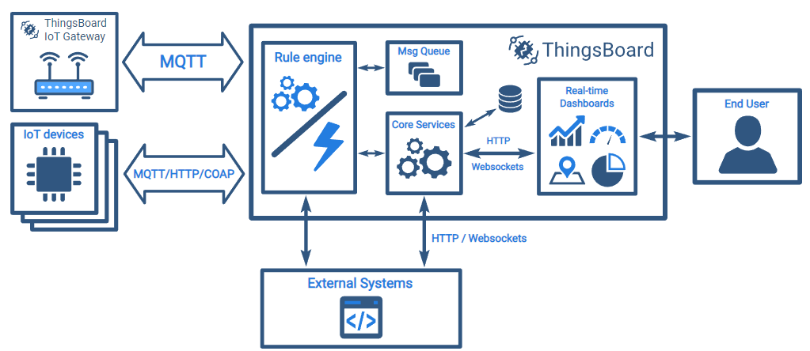
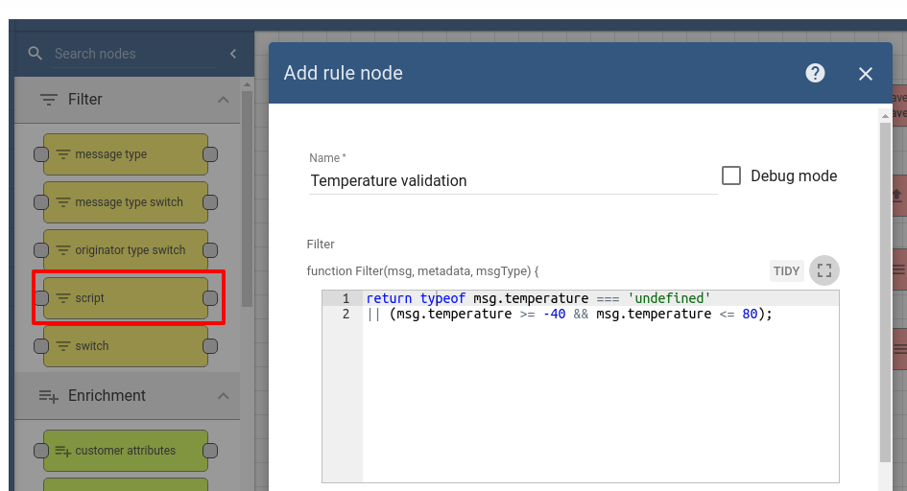
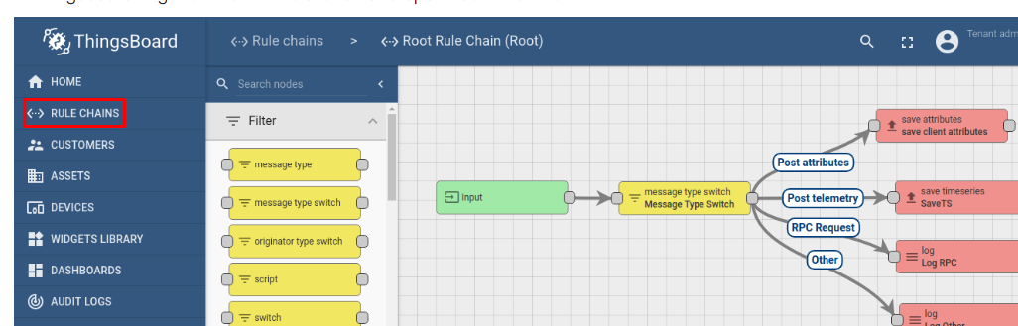
M2M

Slide 87
Meeting 06/09
Attendants: Ander, Loek
Update on implementation progress

Slide 88
M2M
blue: VE
orange: Service
green: PE
cylinder: Data
dash arrow: abstraction
solid arrow: communication
M2M
Ptolemy II
TwinOps
Model1
Model2
M2M
Client
M2M
Client
Server
(rule engine)
database
M2M
Client
Targets
88

Slide 89
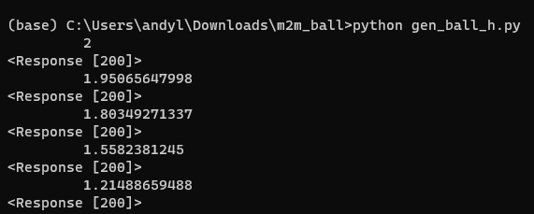
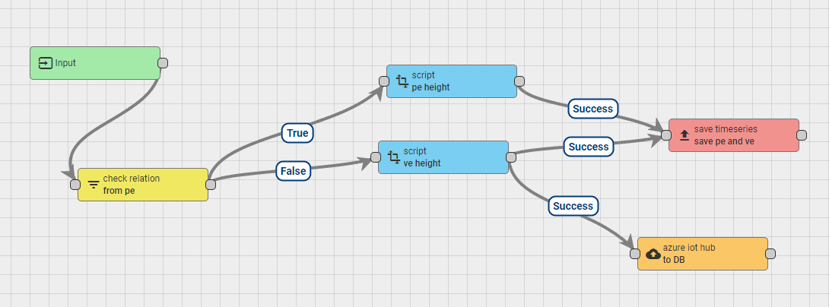
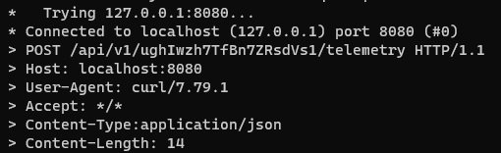
M2M network – Bouncing ball example

Slide 90
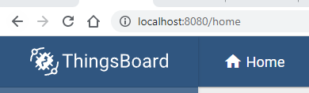
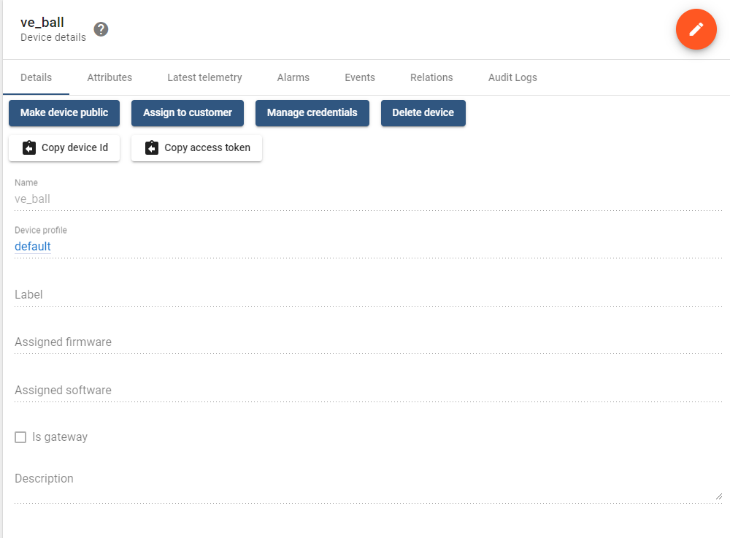
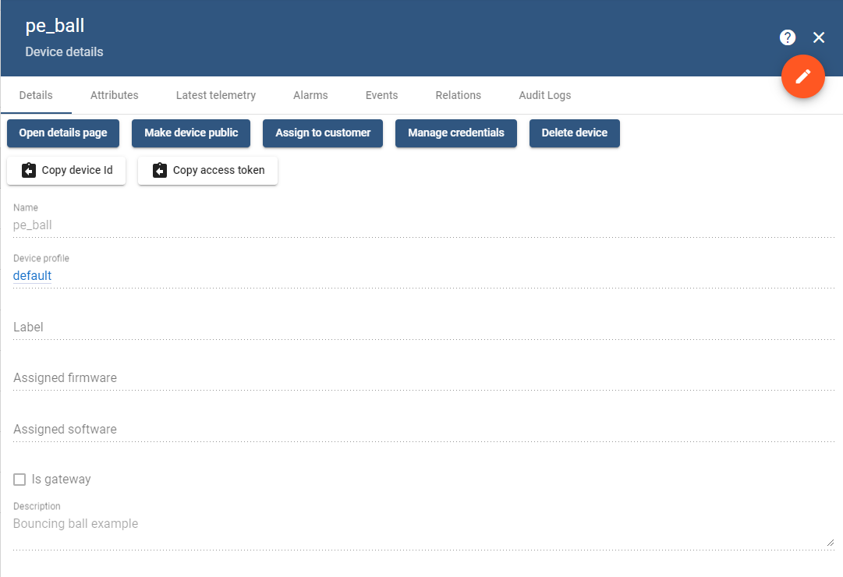
Devices/Models setup

Slide 91
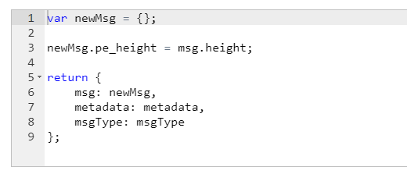
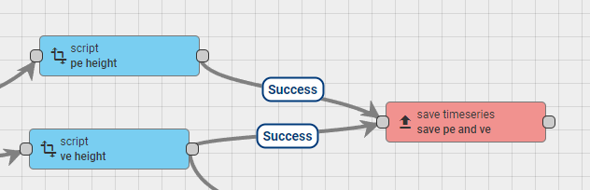
Data integration

Slide 92
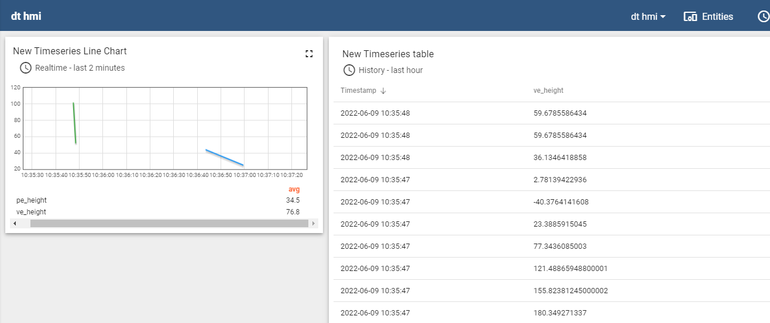
Data analytics

Slide 93
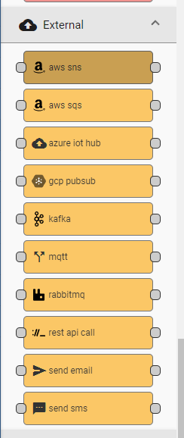
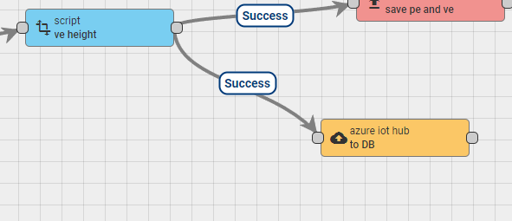
Data sharing

Slide 94
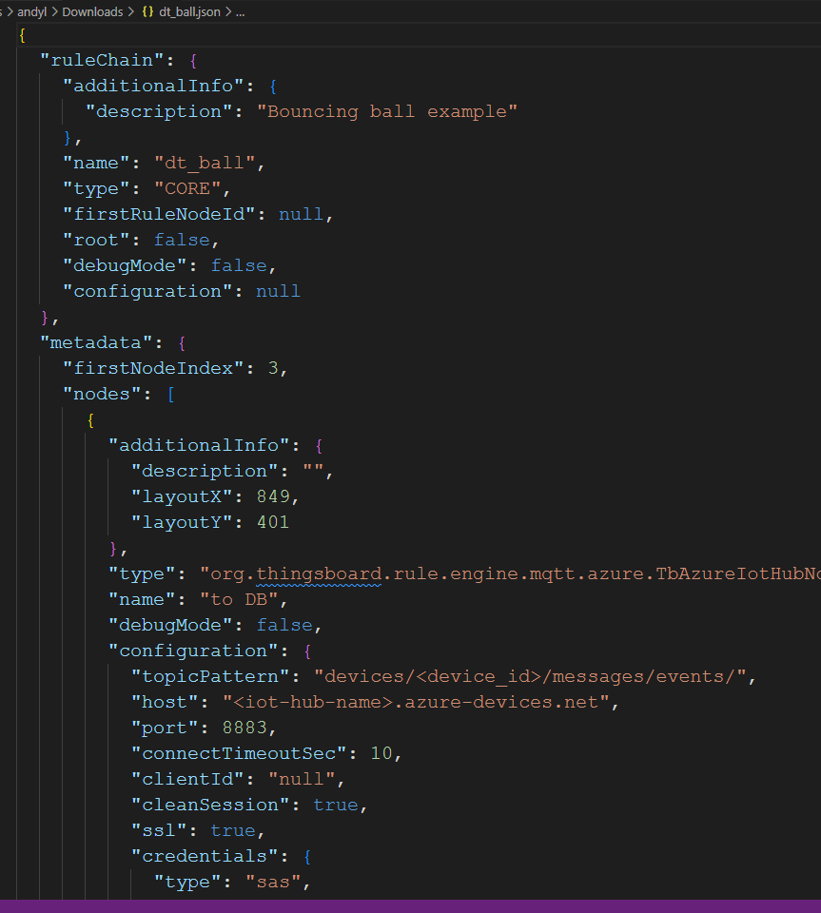
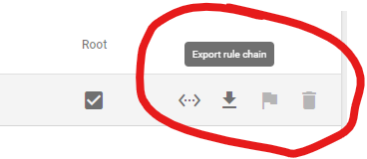
Portability/reconfigurability

Slide 95
Meeting 06/16
Attendants: Ander, David
Progress update

Slide 96
Agenda
TwinOps: basic example demo (p.83)
Re-assess the plan of M2M network (p.84)
M2M: basic example demo (p.89-p.94)
Discuss hardware connection/interface

Slide 97
5D architecture
blue: VE
orange: Service
green: PE
cylinder: Data
dash arrow: abstraction
solid arrow: communication
LwM2M M2M
Ptolemy II
TwinOps
Model1
Model2
FMU1
FMU2
Co-simulation planning
M2M
Client
M2M
Client
CI/CD pipeline
(validation)
M2M
Server
(rule engine)
Source management
database
feedback
Code generation
Container
M2M
Client
Targets
deploy

Slide 98
Meeting 06/30
Attendants: Ander, David
Discuss S1 implementation

Slide 99
Agenda
Matching the requirements for S1 to the current state of implementation
(Inter)networking matters

Slide 100
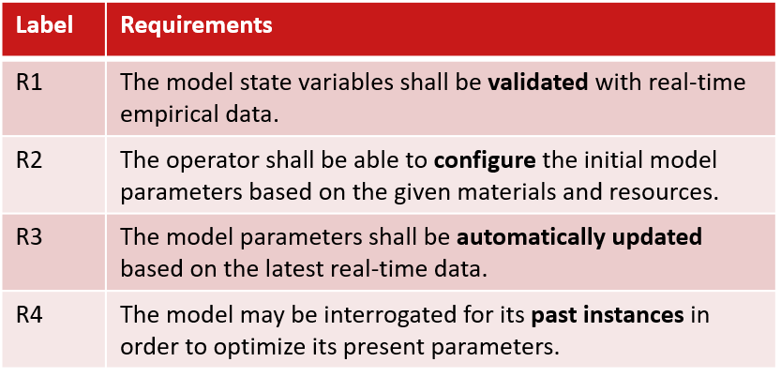
S1 revisit

Slide 101



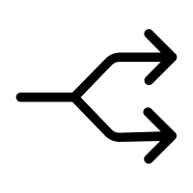
Utility toolkits
Flask: REST lib in Python
SQLAlchemy: DB lib in Python
merge()
split()
Helps communications between entities (VE-PE, VE-DATA…etc), and within the framework (across pipeline stages)

Slide 102
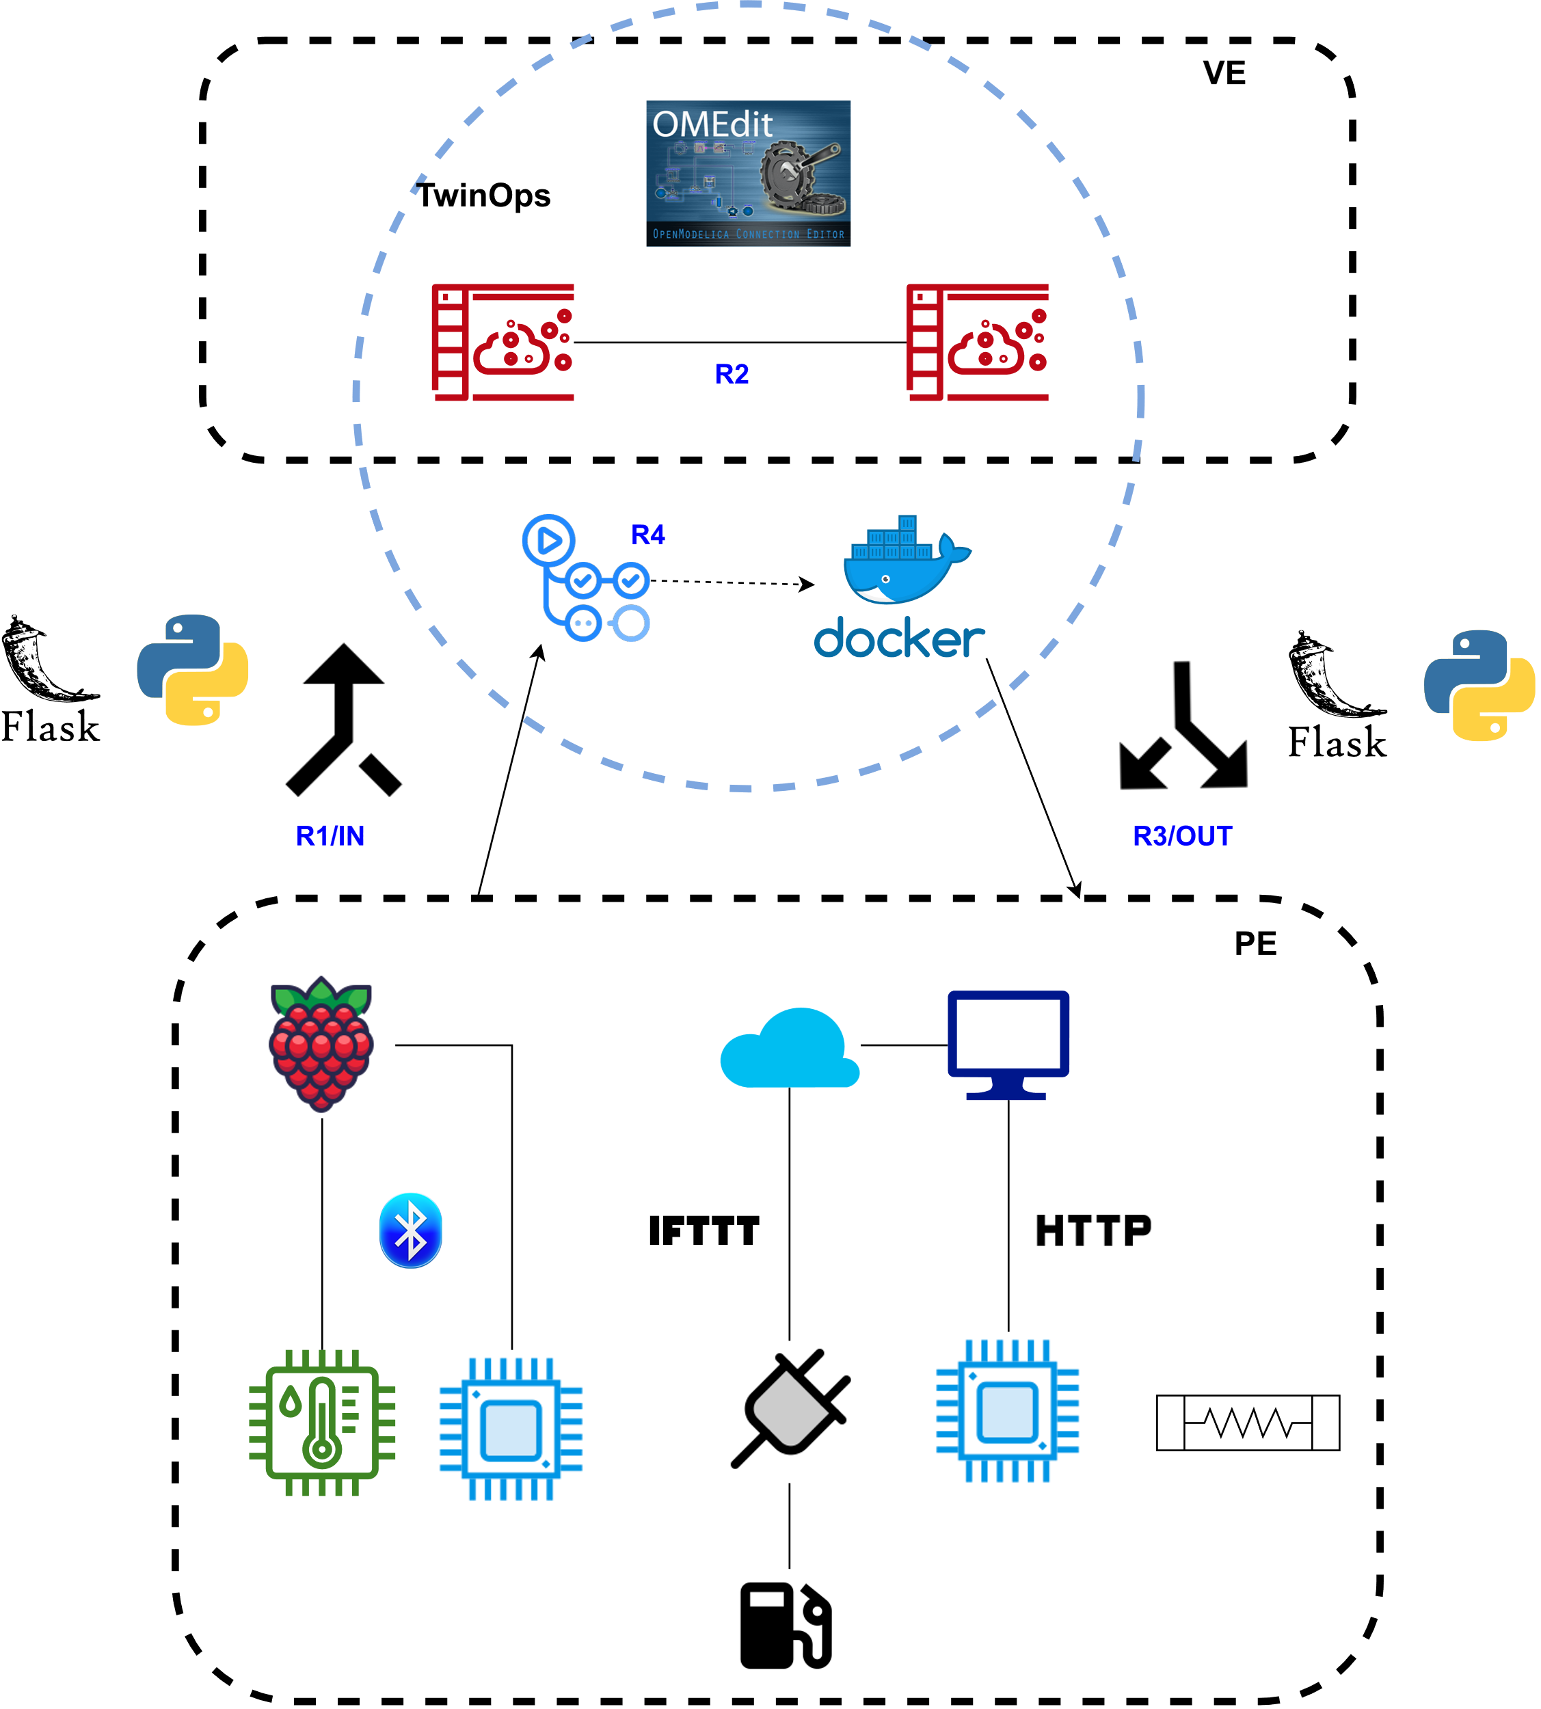
TwinOps

Slide 103
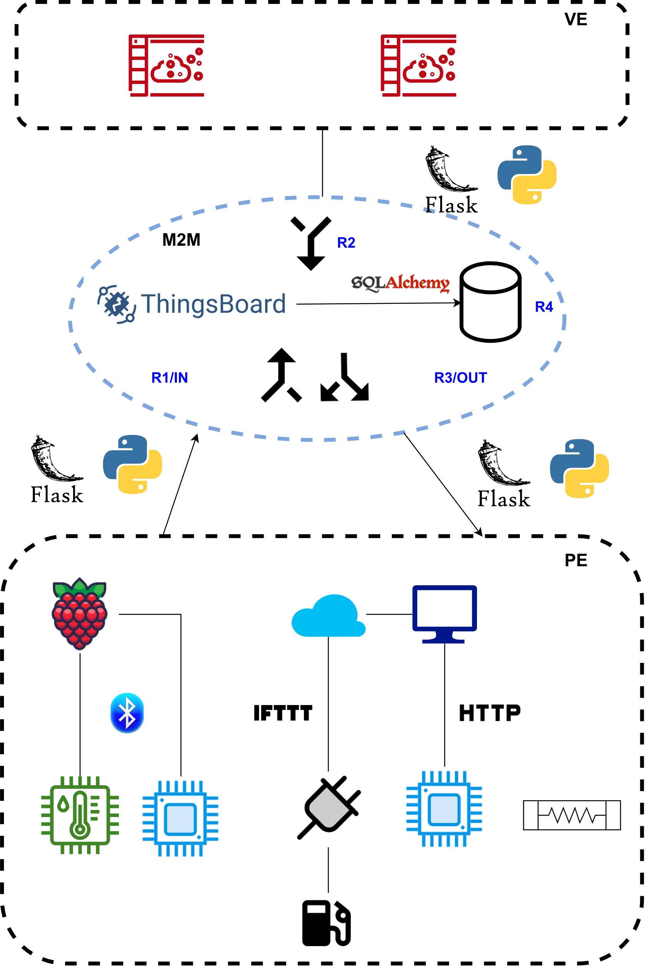
M2M

Slide 104
Meeting 07/07
Attendants: Ander, David
S1 progress update

Slide 105
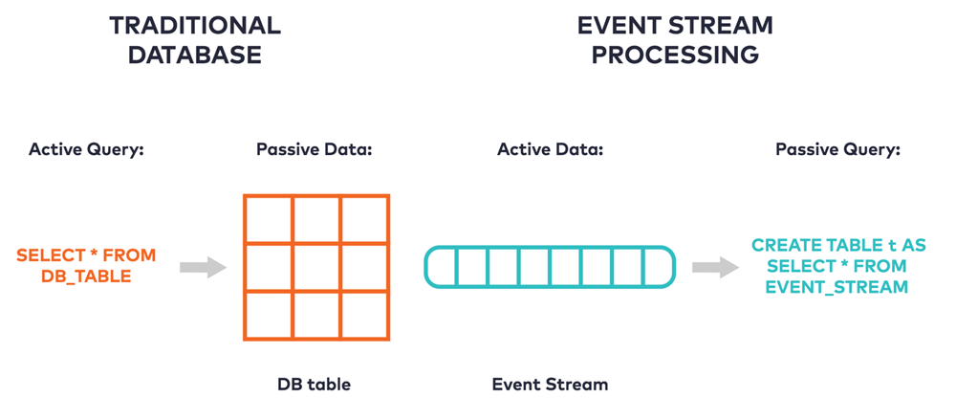
S1 Challenges
Challenges:
Need database
Compartmentalization of parameters and inputs/outputs
Solution:
Kafka
Event streaming
Decouple services
Scalable

Slide 106
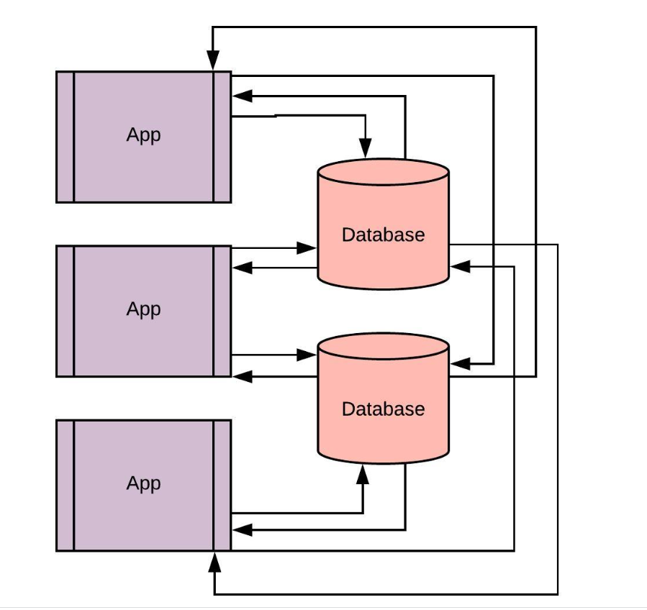
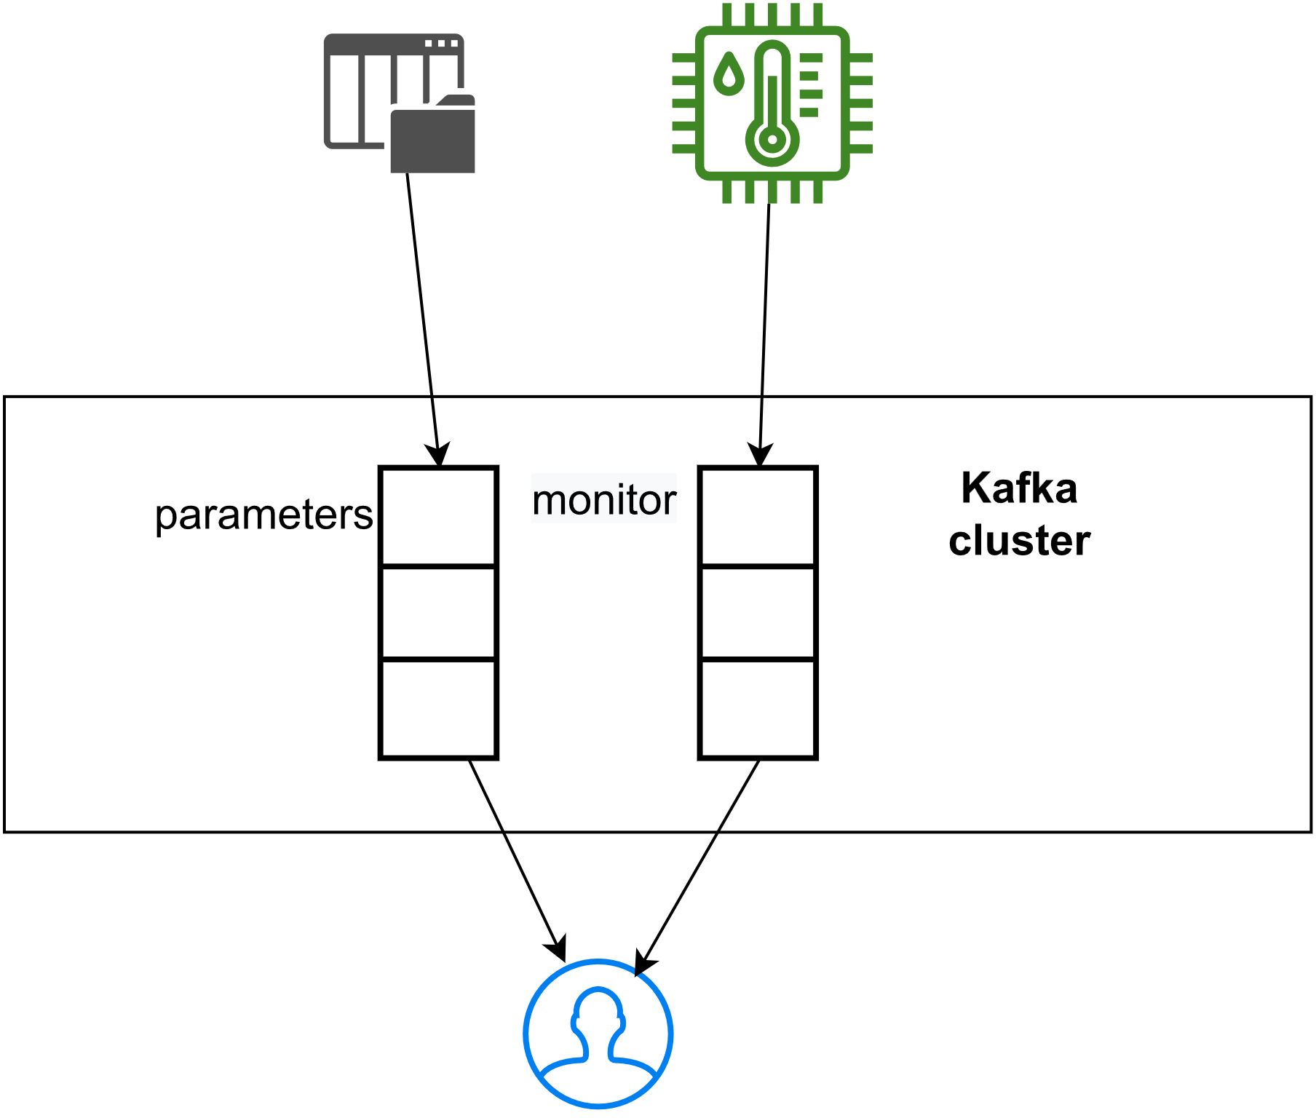
S1 Challenges
Traditional pattern
Kafka

Slide 107
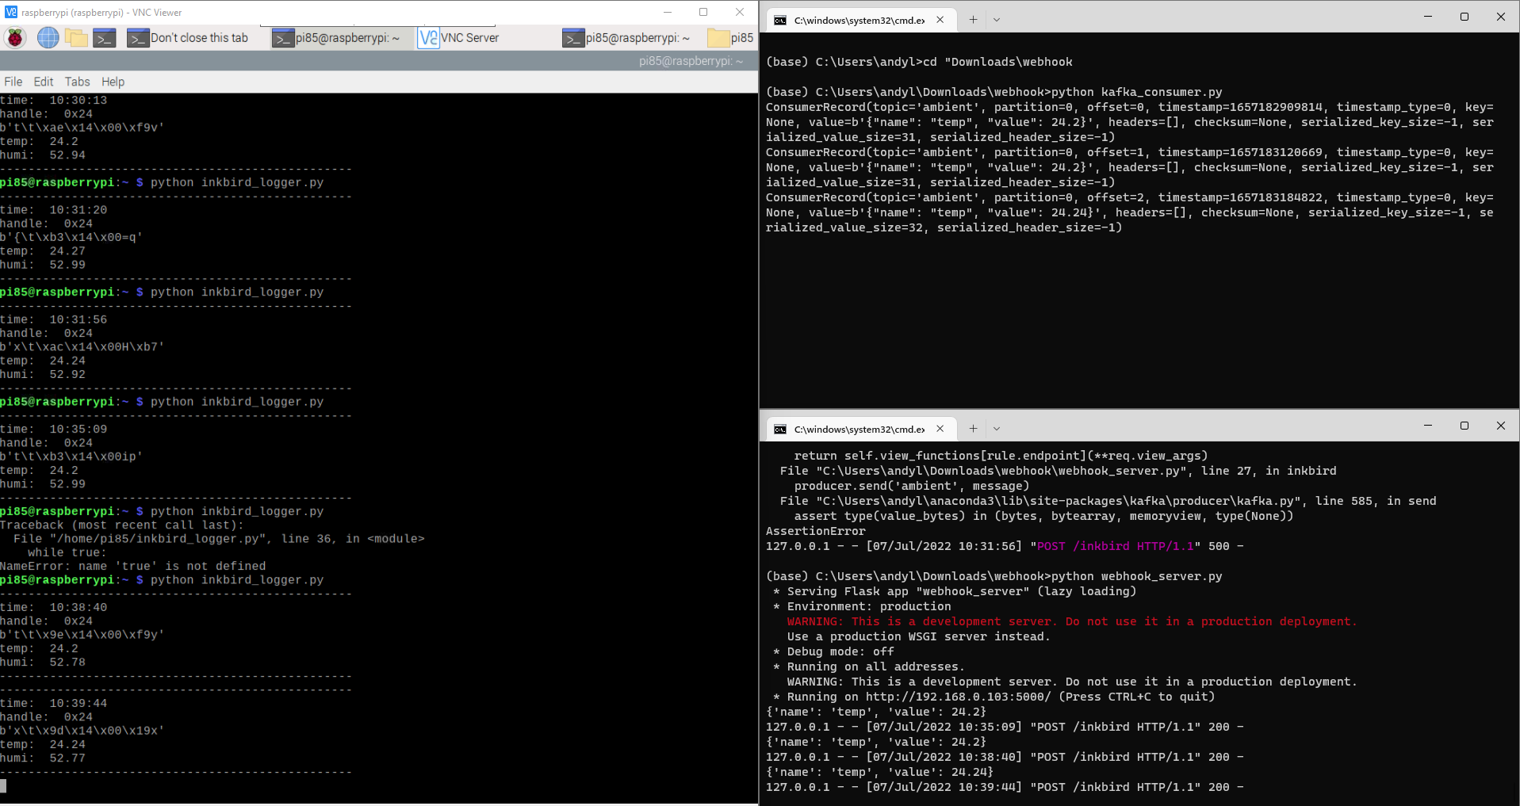
Demo
Model/Kafka consumer
Inkbird sensor
Webhook/Kafka producer

Slide 108
Meeting 07/21
Attendants: Ander, Loek
Overall progress update

Slide 109
Agenda
Report writing
Describe in the system engineering style
Implementation
Sensors and Actuators are OK
Kafka as message queuing system
Ptolemy wrapper
Current issue
Admins

Slide 110
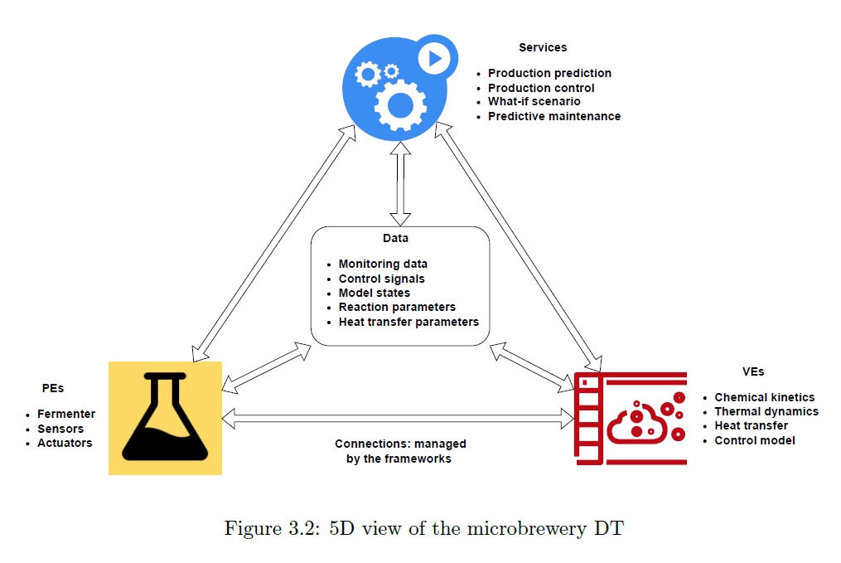
Microbrewery DT in 5D

Slide 111
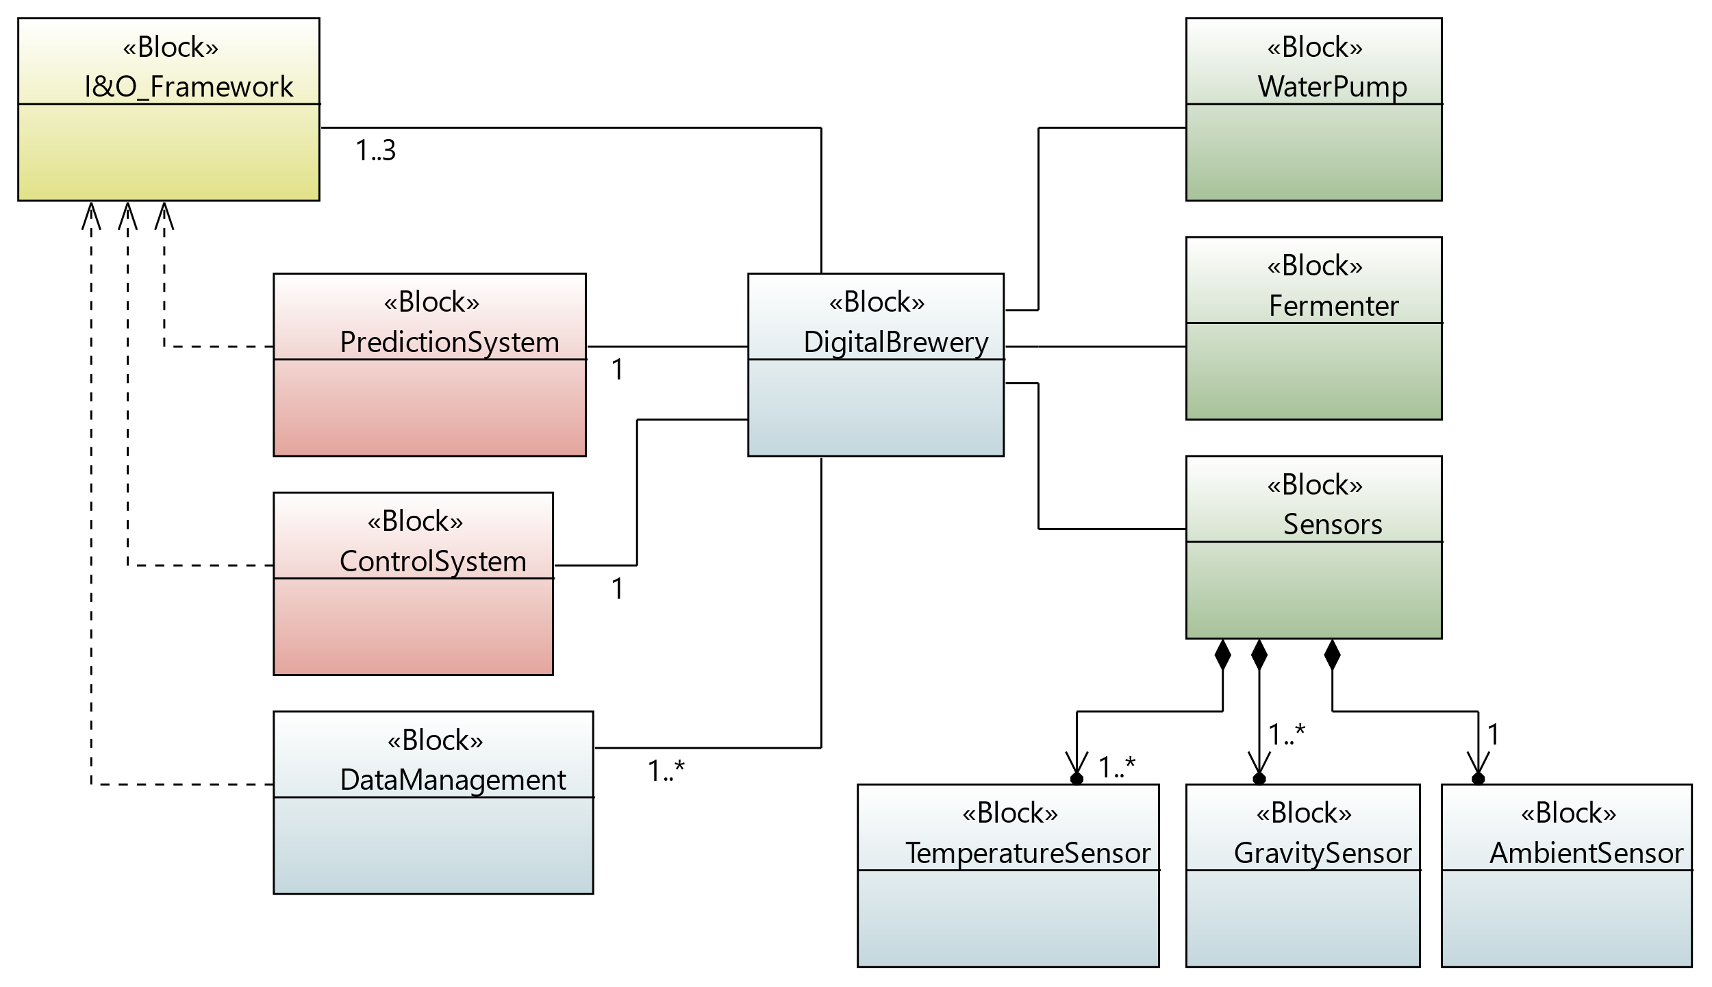
System Context

Slide 112
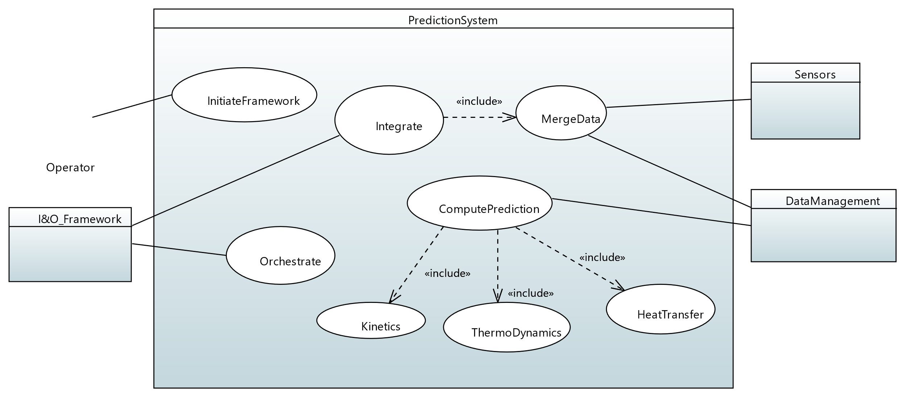

S1 use cases

Slide 113

S2 use cases

Slide 114
Data management with Kafka
Traditional pattern
Kafka

Slide 115
Data management with Kafka

Slide 116

Current issue

Slide 117

Ptolemy wrapper
Depend on hosts
Host Env
Ptolemy Env
model
Host Env
Python socket
model
Host Env
model
FMI
exporter
Depend on middleware

Slide 118
Meeting 08/11
Attendants: Ander, Loek
progress update

Slide 119
Agenda
Progress overview
TwinOps snapshot
ThingsBoard (M2M) snapshot
Ptolemy II errors & (proposed)solutions

Slide 120
Progress overview
TwinOps
Design
Implement
Debug
Test
Benchmark
ThingsBoard
Design
Implement
Debug
Test
Benchmark
Ptolemy 2
Design
Implement
Debug
Test
Benchmark
Report writing
Intro
Background
Methods
Results
Analysis
Conclusion

Slide 121




TwinOps snapshot
Operator config models
Kafka consumer fetches sensors
CI
CD

Slide 122




Closer look at the CI/CD and its artifacts
Simulation logs
DT snapshot

Slide 123


ThingsBoard snapshot
Operator config DT entities
Operator config abstract entities for the service operations

Slide 124

ThingsBoard snapshot
Models trigger
Sensors trigger

Slide 125

ThingsBoard snapshot
Handy built-in widgets for operator control

Slide 126


Ptolemy issues summary (see p.130-134)
Support for FMI still rather experimental !
Many limitations:
no params_set(), not supporting some type of binaries
Coping strategy: roll back to TCP/UDP approach?

Slide 127
A middle-ground solution
3rd party engine for ODE solving
Ptolemy for orchestrating with other models
FMU
TCP/UDP
FMU proxy
Other actors

Slide 128


A middle-ground solution
User defined actor template

Slide 129
Meeting 08/17
Attendants: Ander, David
progress update

Slide 130
Agenda
Discuss the planning for graduation
Ptolemy issues
S2 preparation

Slide 131
Progress overview
TwinOps
Design
Implement
Debug
Test
Benchmark
ThingsBoard
Design
Implement
Debug
Test
Benchmark
Ptolemy 2
Design
Implement
Debug
Test
Benchmark
Report writing
Intro
Background
Methods
Results
Analysis
Conclusion

Slide 132
Planning for the following weeks
- S2 running
- Fix PT2 (hence all frameworks are done)
- Final draft
- presentation
- Depart for IE (09/28)
- Benchmark S1 & S2
- Ch. Analysis
- Ch. Conclusion
(1st full draft)
- 3rd draft
- Rehearse presentation
- 2nd draft
m8w3
m8w4
m9w1
m9w2
m9w3
m9w4
Green: implantation related
Blue: writing related
Brown: presentation related

Slide 133

Ptolemy issue #1
Error: outputs return NaN

Slide 134


Ptolemy issue #1
Root cause: algebraic loops
Ptolemy’s routines: Init() before Set() = ☹️
Other simulator’s routines: Set() before Init() = 🙂

Slide 135

Ptolemy issue #2
Error : failed to accept user defined parameters
Root cause: unclear

Slide 136

Ptolemy issue #3
Error : FMU not supported
Root cause: unsupported library (Python in this case). PTII only supports default FMU (C/C++) or JAVA wrapper. ➔ Inflexibility

Slide 137
Ptolemy issues summary
Support for FMI still rather experimental !
Many limitations:
no params_set(), not supporting some type of binaries
Coping strategy: roll back to TCP/UDP approach?

Slide 138
A middle-ground solution
3rd party engine for ODE solving
Ptolemy for orchestrating with other models
FMU
TCP/UDP
FMU proxy
Other actors

Slide 139
A middle-ground solution
User defined actor template

